Slide 1
Test-inspired runtime verification
2014-02-20 – Degree project by Adam Renberg

Slide 2
Preface
A degree project at CSC KTH
Supervisor KTH: Narges Khakpour
Examiner: Johan Håstad
Company: Valtech
Supervisor Valtech: Erland Ranvinge

Slide 3
Test-inspired runtime verification

Slide 4
Overview
Intro
Problem
Background
Short introduction to Runtime Verification
Short introduction to Unit Testing
Approach
Instrumentation
Syntax
Formalization
Evaluation
Conclusions

Slide 5
Intro
Quality assurance and monitoring
Verification
Formal v. informal
Tools, ease of use
Notes:
Increasing application complexity
Quality assurance and monitoring
Simple and familiar to developers used to other means of testing (e.g. unit tests)
Context switching?
Runtime verification
Formal?
Why pythonrv?

Slide 6
Problem
Can we use the concepts of runtime verification to write specifications in the target program’s programming language?
Can we still give the specification a formal semantics?
Notes:
How to make runtime verification “familiar to developers”?
Bridging the gap between formal verification and other well-known means of testing?
Can we still give a formal semantics to the specification language, or a part of it?

Slide 7
Background
Notes:
Short about verification in general
A bit longer about Runtime Verification
A bit, not very long, about unit testing (and testing in general?)

Slide 8
Verification
Verify that a system follows its specification
System model
Formal, e.g. theorem proving, model checking
Testing
Problems
Notes:
“Are we building the program correctly?”
A system model is a construct. Representation of the system. Abstraction. Use everyday, hide unimportant features.
Formal: Hoare, Floyd, Pnueli
Mathematical repr. System model. Of specification.
Proof is a certificate that the program follows its spec.
Problems F: Complex, hard to automate. Difficult for large programs.
Problems T: Incomplete, informal
Combinatorial problems, testing all cases

Slide 9
Runtime verification
Verifies the execution of a program
Code instrumentation and monitors
Formal v. informal
Online v. offline
Notes:
Specifications assert properties on the execution

Slide 10
Runtime verification
Specifications
Linear Temporal Logic (Pnueli)
Notes:
Modal logic. Calculi.

Slide 11
Runtime verification
Code instrumentation.
Pre and post processing code
Dynamic code rewriting
Aspects
No instrumentation

Slide 12
Testing and unit testing
Small, isolated parts of the system
Test suites and test cases
Prevalent in software development
Test-driven development
Notes:
Next: example

Slide 13
Unit test in Python
import random
import unittest
class TestSequenceFunctions(unittest.TestCase):
def setUp(self):
self.seq = range(10)
def test_shuffle(self):
random.shuffle(self.seq)
self.seq.sort()
self.assertEqual(self.seq, range(10))
def test_choice(self):
element = random.choice(self.seq)
self.assertTrue(element in self.seq)
def test_sample(self):
with self.assertRaises(ValueError):
random.sample(self.seq, 20)
for element in random.sample(self.seq, 5):
self.assertTrue(element in self.seq)
http://docs.python.org/2/library/unittest.html#basic-example

Slide 14
Approach

Slide 15
Approach
Python: pythonrv
Dynamic code instrumentation
Specification functions
Formalization – python subset, system model

Slide 16
Instrumentation
Dynamic code injection
Part of the system
External to the system

Slide 17
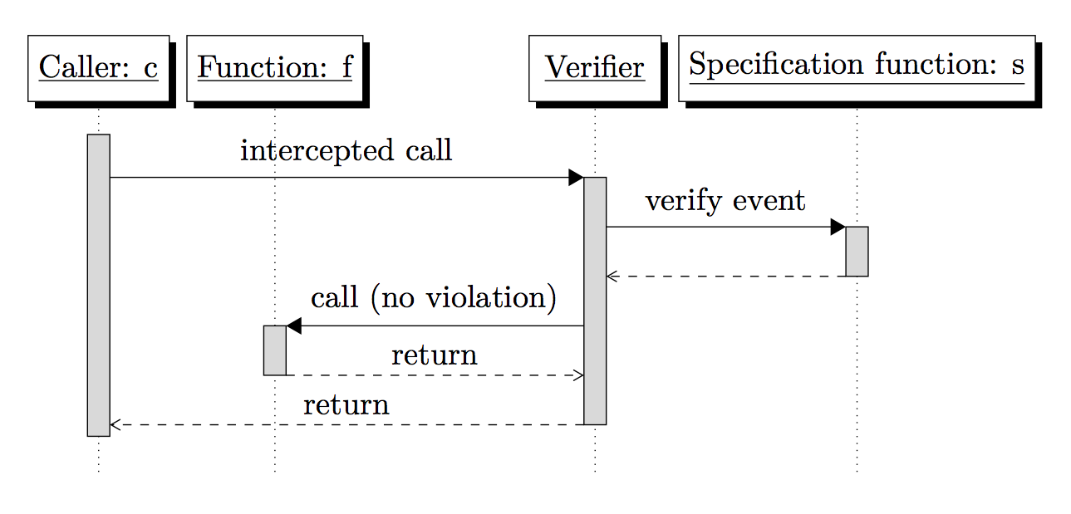
Flow sequence for pythonrv

Slide 18
Fibonnaci
# in file fib.py
def fibonnaci(n):
if (n <= 2):
return 1
return fibonnaci(n-1) + fibonnaci(n-2)

Slide 19
Fibonnaci (spec 1)
from pythonrv import rv
import fib
@rv.monitor(func=fib.fibonnaci)
def positive_inputs(event):
assert event.fn.func.inputs[0] > 0

Slide 20
Fibonnaci (spec 2)
from pythonrv import rv
import fib
@rv.monitor(func=fib.fibonnaci)
@rv.spec(when=rv.POST)
def positive_output(event):
assert event.fn.func.result > 0

Slide 21
Temporal properties
from pythonrv import rv
from target import lock, unlock
@rv.monitor(lock=lock, unlock=unlock)
def must_unlock_after_lock(event):
if (event.fn.lock.called):
def verify_unlock(event):
assert event.fn.unlock.called
event.next(verify_unlock)
@rv.monitor(lock=lock, unlock=unlock)
def only_unlock_if_locked(event):
if (event.fn.unlock.called):
assert event.prev.fn.lock.called
Notes:
Resource leaks

Slide 22
Formalization

Slide 23
Formalization
Formal pythonrv: f-pythonrv.
Transform specification function to automaton
Compute product with system model
Compute reachability
Notes:
Labeled transition system

Slide 24
Structure of f-pythonrv spec
s ::= ε
| assert E
| next s
| if E then s
| if E then s else s′
| s ; s′
Notes:
Structure of a formal specification (function)

Slide 25
Fibonnaci (formal spec)
from pythonrv import rv
from pythonrv.formalrv import (formal_spec, make_assert, make_next)
import fib
@rv.monitor(func=fib.fibonnaci)
@formal_spec
def positive_inputs():
return make_assert(lambda event:
event.fn.func.inputs[0] > 0)
+ make_next(lambda: positive_inputs)

Slide 26
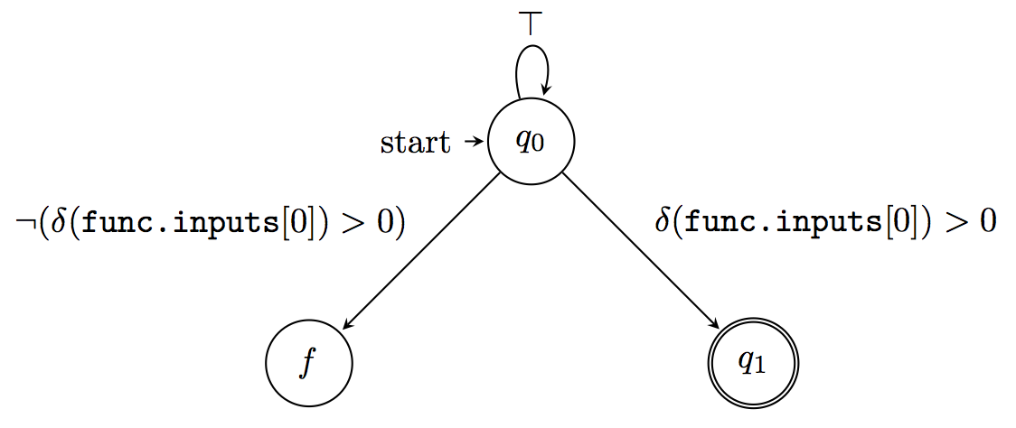
Formal spec (automaton)

Slide 27
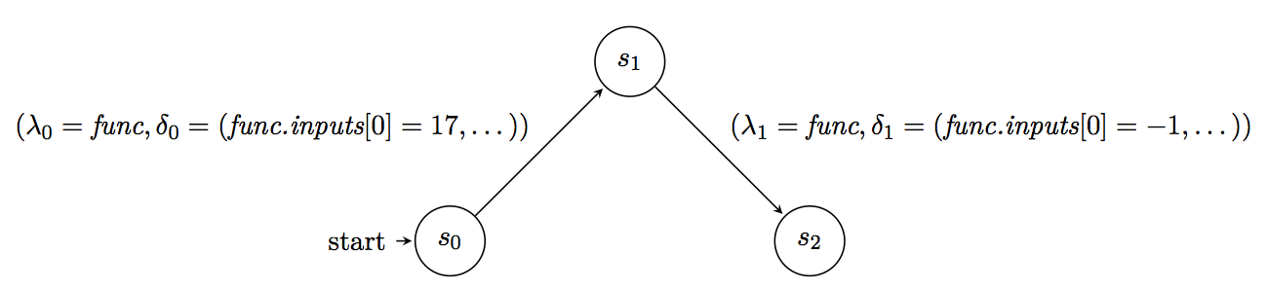
System model

Slide 28
Verification
Compute the product
Compute reachability
Fail state ➔ violation
Only success states ➔ satisfaction
Neither ➔ continue

Slide 29
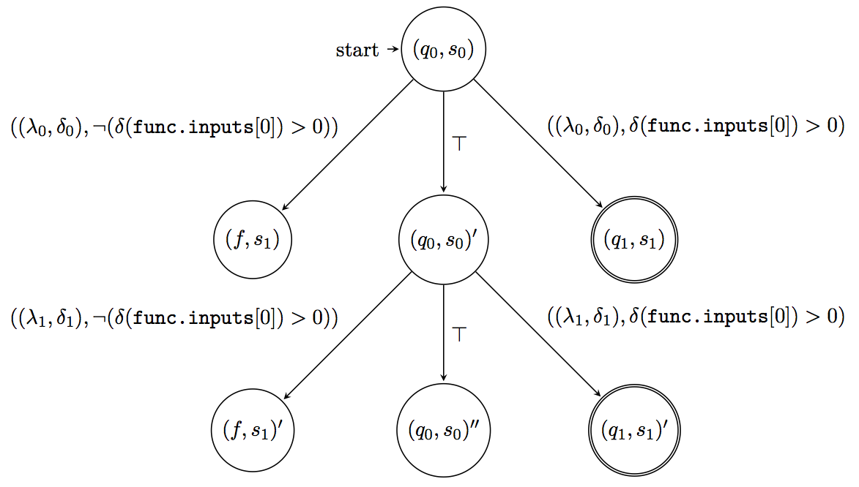
Verification
Notes:
Reachability.
Leaf states.

Slide 30
Evaluation
Field testing: Try on a real-life application

Slide 31
Evaluation, background
Valtech intranet
Python and Django based
Runs on Heroku Cloud
200 active users every day
Notes:
Web site
Django is a popular web framework

Slide 32
An example specification
“Users must authenticate to view certain pages.”
Informal specification
Formal specification

Slide 33
Informal specification
from pythonrv import rv
from django.core.handlers.base import BaseHandler
rv.configure(enable_copy_args=False)
@rv.monitor(bh=BaseHandler.get_response)
@rv.spec(when=rv.POST)
def ensure_auth(event):
request = event.called_function.inputs[1]
response = event.called_function.result
if requires_auth(request, response):
assert (request.user.is_authenticated(),
"The current user is not authenticated")
assert (request.user.is_active,
"The current user is not active”)
def requires_auth(req, res):
if res.status_code != 200:
return False
if (req.path.startswith("/login") or
req.path.startswith("/appmedia")):
return False
return True

Slide 34
Formal specification
from pythonrv import rv
from pythonrv.formalrv import formal_spec, make_if, make_assert
from django.core.handlers.base import BaseHandler
rv.configure(enable_copy_args=False)
@rv.monitor(bh=BaseHandler.get_response)
@rv.spec(when=rv.POST)
@formal_spec
def ensure_auth():
auth = make_assert(lambda e:
e.called_function.inputs[1].user.is_authenticated())
active = make_assert(lambda e:
e.called_function.inputs[1].user.is_active)
loop = make_next(lambda: ensure_auth)
return make_if(requires_auth, auth + active) + loop
def requires_auth(event):
return event.called_funcion.result.status_code == 200 and \
not event.called_function.inputs[1].path.startswith("/login") and \
not event.called_function.inputs[1].path.startswith("/appmedia")

Slide 35
Conclusions

Slide 36
1. Syntax
How can runtime verification specifications be written in a manner that uses the syntax of the target program’s programming language, and resembles the structure of unit tests?
Python is powerful

Slide 37
2. Unit Testing
How can we bridge the spectrum of different approaches for verification, creating something in between the formal and informal techniques?
Domain language, more familiar

Slide 38
2. Formalization
Can we still give a formal semantics to the specification language, or a part of it?
Possible
Hard
Makes math easier, code more ugly

Slide 39
Future work
Simpler formal specifications
Formalize more of Python?
Performance evaluation
Offline verification
More field testing
Use more ideas from unit testing

Slide 40
Questions?

Slide 41
Thank you
Slide templates courtesy of Valtech

